Slide 1
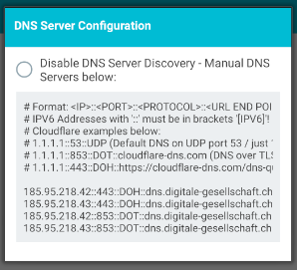
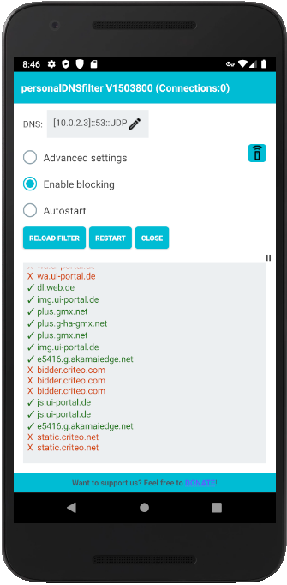
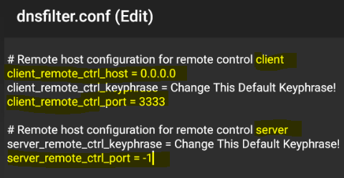
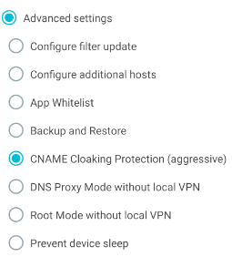
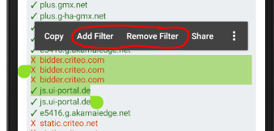
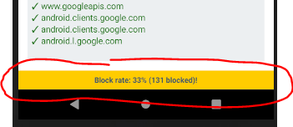
For remote controlling remote running instance (to enable, edit dnsfilter.conf file in filesystem)
Enable / Disable Blocking
Enable / Disable Autostart
Pause and resume live log
Life Log showing blocked and allowed DNS requests
Black / whitelist directly from live log
Short touch will show block rate

Slide 2
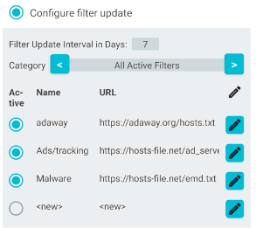
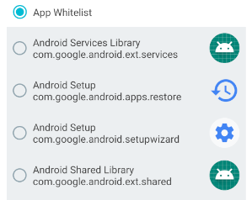
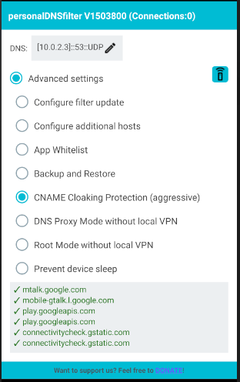
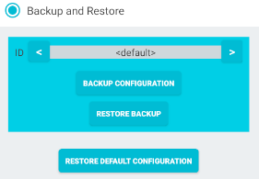
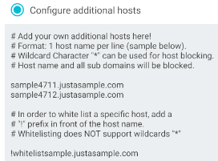
Select Apps to be excluded from filtering
Config Backup and Restore
With this option also the CNAME redirects are checked against the filter and thus prevents the so-called CNAME Cloaking
Option to prevent that device goes to sleep (e.g. when running DNS Proxy for the whole network)
By default personalDNSfilter on Android is creating a local VPN in order to capture and reroute the DNS request.
The option “DNS proxy Mode” disables this behavior and only starts a DNS proxy on port 5300 (port 53 is not possible on non-rooted device). You can use this option in combination with “OpenVPN for pDNSf” for connecting a real VPN by using local filtering.
The option “Root Mode” additionally opens port 53 and routes all local DNS traffic via personalDNSfilter. You can use any VPN client in combination with this mode.
In addition this mode allows to use personalDNSfilter from within your whole network by setting it as the DNS server in your network.

